Slide 1
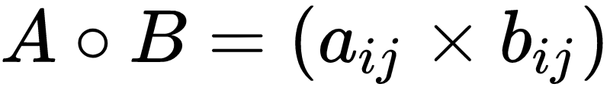
Matrix Operations: Matrix Multiplication
Element-wise matrix multiplication, also known as the Hadamard product (￮)
  Only defined for matrices with the same row and column dimensions
1 | 0 | 1
0 | 1 | 0
1 | 1 | 1
0 | 0 | 0
1 | 1 | 1
1 | 0 | 1
0 | 0 | 0
0 | 1 | 0
1 | 0 | 1
A _{3 x 3}
B _{3 x 3}
C_{3 x 3}

Slide 2
Matrix Operations: Matrix Multiplication
Matrix multiplication proper (✕)
  Only defined for conformable matrices
  Two matrices (e.g., A and B) are conformable if the number of columns of the first is the same as the number of rows of the second
A_{4 x 2} ✕ B_{2 x 3}
Number of Columns of the A matrix
Number of Rows of the B matrix

Slide 3
Matrix Operations: Matrix Multiplication
A_{4 x 2} ✕ B_{2 x 3}
A_{4 x 3} ✕ B_{2 x 3}
Inner dimensions
Inner dimensions
Outer dimensions
.
Outer dimensions
.
B _{2 x 3}
B _{2 x 3}
A _{4 x 3}
A _{4 x 2}

Slide 4
Matrix Operations: Matrix Multiplication
A_{4 x 2} ✕ B_{2 x 3}
A_{4 x 3} ✕ B_{2 x 3}
Inner dimensions match! Matrices are conformable
Inner dimensions don’t match! Matrices are not conformable
Inner dimensions
Inner dimensions
Outer dimensions
.
Outer dimensions
.
B _{2 x 3}
B _{2 x 3}
A _{4 x 3}
A _{4 x 2}

Slide 5


Matrix Operations: Matrix Multiplication
A_{4 x 2} ✕ B_{2 x 3}
A_{4 x 3} ✕ B_{2 x 3}
Inner dimensions match! Matrices are conformable
Inner dimensions don’t match! Matrices are not conformable
Inner dimensions
Inner dimensions
Outer dimensions
.
Outer dimensions
.
B _{2 x 3}
B _{2 x 3}
A _{4 x 3}
A _{4 x 2}

Slide 6
Matrix Operations: Matrix Multiplication
A_{4 x 2} ✕ B_{2 x 3}
A_{4 x 3} ✕ B_{2 x 3}
Inner dimensions match! Matrices are conformable
Inner dimensions don’t match! Matrices are not conformable
Inner dimensions
Inner dimensions
Outer dimensions
.
Outer dimensions
.
In general you can multiply any A_{m x n} matrix ✕ any B _{q x p} matrix:
  So long as n = q
  It doesn’t matter what the values of the outer dimensions is

Slide 7
Matrix Operations: Matrix Multiplication
A_{3 x 2} ✕ B_{2 x 4} = C_{3 x 4}
A_{3 x 2} ✕ B_{3 x 4} = Not defined
Inner dimensions
Inner dimensions
Product matrix C is 3 X 4 same as the outer dimensions
Outer dimensions
.
Outer dimensions
.
The outer dimensions determine the dimensions of the resulting matrix such that A_{m x n} ✕ B _{q x p} = C _{m x p}

Slide 8
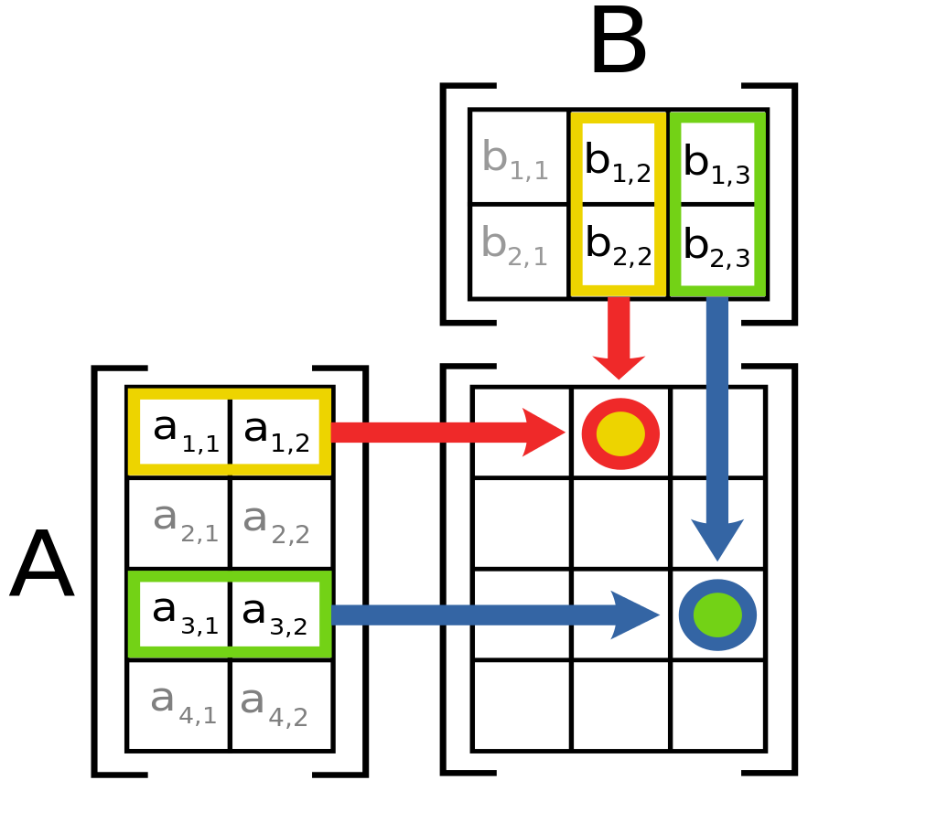
Matrix Operations: Matrix Multiplication
a | b
c | d
e | f
g | h
=
a * e + b * g | a * f + b * h
c * e + d * g | c * f + d * h
X
2 x 2
2 x 2
2 x 2
How does it work?
For A X B:
  The ij cell of the resulting matrix is given by the sum of the product of the corresponding cells of row i in A and column j of B

Slide 9
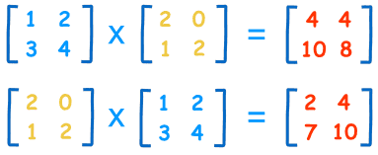
Matrix Operations: Matrix Multiplication
a | b
c | d
e | f
g | h
=
a * e + b * g | a * f + b * h
c * e + d * g | c * f + d * h
X
2 x 2
2 x 2
2 x 2

Slide 10
Matrix Operations: Matrix Multiplication
a | b
c | d
e | f
g | h
=
a * e + b * g | a * f + b * h
c * e + d * g | c * f + d * h
X
2 x 2
2 x 2
2 x 2
C₁₁ = (1 * 2) + (2 * 1) = 4
A
B
C

Slide 11
Matrix Operations: Matrix Multiplication
a | b
c | d
e | f
g | h
=
a * e + b * g | a * f + b * h
c * e + d * g | c * f + d * h
X
2 x 2
2 x 2
2 x 2
C₂₁ = (3 * 2) + (4 * 1) = 10
A
B
C

Slide 12
Matrix Operations: Matrix Multiplication
Properties of matrix multiplication:
  Not commutative!
    A X B ≠ B X A
    A X B can be defined but the reverse is no the case
  Associative:
    (A X B) X C = A X (B X C)
  Distributive over addition:
    A X (B + C) = (A X B) + (A X C)

Slide 13
Matrix Operations: Matrix Multiplication
Properties of matrix multiplication:
  Square matrices of the same dimension can always be multiplied
  A square matrix is one in which the row and column dimensions are of the same size
  Network adjacency matrices are square matrices
  You can take matrix powers by self-multiplication:
    A² = A X A
    A³ = A X A X A
    A^{k} = A X A X A ....(k times)

Slide 14


Undirected Graph
 | a | b | c | d | e
a | -- | 1 | 0 | 0 | 0
b | 1 | -- | 1 | 0 | 0
c | 0 | 1 | -- | 1 | 1
d | 0 | 0 | 1 | -- | 1
e | 0 | 0 | 1 | 1 | --
 | a | b | c | d | e
a | -- | 1 | 0 | 0 | 0
b | 1 | -- | 1 | 0 | 0
c | 0 | 1 | -- | 1 | 1
d | 0 | 0 | 1 | -- | 1
e | 0 | 0 | 1 | 1 | --
X
=
What happens if we take the second power of a network adjacency matrix?

Slide 15
What happens if we take the second power of a network adjacency matrix?
Undirected Graph
 | a | b | c | d | e
a | 0 | 1 | 0 | 0 | 0
b | 1 | 0 | 1 | 0 | 0
c | 0 | 1 | 0 | 1 | 1
d | 0 | 0 | 1 | 0 | 1
e | 0 | 0 | 1 | 1 | 0
 | a | b | c | d | e
a | 0 | 1 | 0 | 0 | 0
b | 1 | 0 | 1 | 0 | 0
c | 0 | 1 | 0 | 1 | 1
d | 0 | 0 | 1 | 0 | 1
e | 0 | 0 | 1 | 1 | 0
 | a | b | c | d | e
a
b
c
d
e
X
=
A_{5 x 5}
A_{5 x 5}
A²_{5 x 5}

Slide 16
What happens if we take the second power of a network adjacency matrix?
Undirected Graph
A²_{1, 3} = (0 * 0) + (1 * 1) + (0 * 0) + (0 * 1) + (0 * 1) = 1
 | a | b | c | d | e
a | 0 | 1 | 0 | 0 | 0
b | 1 | 0 | 1 | 0 | 0
c | 0 | 1 | 0 | 1 | 1
d | 0 | 0 | 1 | 0 | 1
e | 0 | 0 | 1 | 1 | 0
 | a | b | c | d | e
a | 0 | 1 | 0 | 0 | 0
b | 1 | 0 | 1 | 0 | 0
c | 0 | 1 | 0 | 1 | 1
d | 0 | 0 | 1 | 0 | 1
e | 0 | 0 | 1 | 1 | 0
 | a | b | c | d | e
a |  |  | 1
b
c
d
e
X
=
A_{5 x 5}
A_{5 x 5}
A²_{5 x 5}
To figure out which number goes in cell (1,3) of the target matrix we use the numbers from
row 1 of first matrix and column 3 of the second matrix and do same for each of the 25 (i,j) cells

Slide 17
There is a one in the ij^{th} cell of the squared matrix if and j are connected by a walk of length 2!
Undirected Graph
 | a | b | c | d | e
a | 0 | 1 | 0 | 0 | 0
b | 1 | 0 | 1 | 0 | 0
c | 0 | 1 | 0 | 1 | 1
d | 0 | 0 | 1 | 0 | 1
e | 0 | 0 | 1 | 1 | 0
 | a | b | c | d | e
a | 0 | 1 | 0 | 0 | 0
b | 1 | 0 | 1 | 0 | 0
c | 0 | 1 | 0 | 1 | 1
d | 0 | 0 | 1 | 0 | 1
e | 0 | 0 | 1 | 1 | 0
 | a | b | c | d | e
a | 1 | 0 | 1 | 0 | 0
b | 0 | 2 | 0 | 1 | 1
c | 1 | 0 | 3 | 1 | 1
d | 0 | 1 | 1 | 2 | 1
e | 0 | 1 | 1 | 1 | 2
X
=
A_{5 x 5}
A_{5 x 5}
A²_{5 x 5}
Here’s the result (check here)

Slide 18
There is a one in the ij of the squared matrix if and j are connected via a walk of length 2!
The diagonal is the number of walks of length 2 that begin and end at that vertex which equals the number of links attached to that node!
Undirected Graph
 | a | b | c | d | e
a | 0 | 1 | 0 | 0 | 0
b | 1 | 0 | 1 | 0 | 0
c | 0 | 1 | 0 | 1 | 1
d | 0 | 0 | 1 | 0 | 1
e | 0 | 0 | 1 | 1 | 0
 | a | b | c | d | e
a | 0 | 1 | 0 | 0 | 0
b | 1 | 0 | 1 | 0 | 0
c | 0 | 1 | 0 | 1 | 1
d | 0 | 0 | 1 | 0 | 1
e | 0 | 0 | 1 | 1 | 0
 | a | b | c | d | e
a | 1 | 0 | 1 | 0 | 0
b | 0 | 2 | 0 | 1 | 1
c | 1 | 0 | 3 | 1 | 1
d | 0 | 1 | 1 | 2 | 1
e | 0 | 1 | 1 | 1 | 2
X
=
A_{5 x 5}
A_{5 x 5}
A²_{5 x 5}
Here’s the result (check here)

Slide 19
What happens if we take the third power of the adjacency matrix?
Undirected Graph
 | a | b | c | d | e
a | 0 | 1 | 0 | 0 | 0
b | 1 | 0 | 1 | 0 | 0
c | 0 | 1 | 0 | 1 | 1
d | 0 | 0 | 1 | 0 | 1
e | 0 | 0 | 1 | 1 | 0
 | a | b | c | d | e
a | 1 | 0 | 1 | 0 | 0
b | 0 | 2 | 0 | 1 | 1
c | 1 | 0 | 3 | 1 | 1
d | 0 | 1 | 1 | 2 | 1
e | 0 | 1 | 1 | 1 | 2
X
=
A_{5 x 5}
A²_{5 x 5}

Slide 20
Now we have all walks of length 3 between every node!
We can keep on going until we reach N (the graph order)
Undirected Graph
 | a | b | c | d | e
a | 0 | 1 | 0 | 0 | 0
b | 1 | 0 | 1 | 0 | 0
c | 0 | 1 | 0 | 1 | 1
d | 0 | 0 | 1 | 0 | 1
e | 0 | 0 | 1 | 1 | 0
 | a | b | c | d | e
a | 1 | 0 | 1 | 0 | 0
b | 0 | 2 | 0 | 1 | 1
c | 1 | 0 | 3 | 1 | 1
d | 0 | 1 | 1 | 2 | 1
e | 0 | 1 | 1 | 1 | 2
 | a | b | c | d | e
a | 0 | 2 | 0 | 1 | 1
b | 2 | 0 | 4 | 1 | 1
c | 0 | 4 | 2 | 4 | 4
d | 1 | 1 | 4 | 2 | 3
e | 1 | 1 | 4 | 3 | 2
X
=
A_{5 x 5}
A²_{5 x 5}
A³_{5 x 5}

Slide 21
Undirected Graph
Undirected Graph
 | a | b | c | d | e
a | 2 | 0 | 4 | 1 | 1
b | 0 | 6 | 2 | 5 | 5
c | 4 | 2 | 12 | 6 | 6
d | 1 | 5 | 6 | 7 | 6
e | 1 | 5 | 6 | 6 | 7
 | a | b | c | d | e
a | 0 | 6 | 2 | 5 | 5
b | 6 | 2 | 16 | 7 | 7
c | 2 | 16 | 14 | 18 | 18
d | 5 | 7 | 18 | 12 | 13
e | 5 | 7 | 16 | 13 | 12
W_{k = 4}
W_{k = 5}
Taking the k powers of an adjacency matrix A gives us a valued matrix W, where the w_{ij} is a measure of the multiple ways i can reach j via a walk of length k in the original matrix

Slide 22
Individual Level in Networks I
Ego-Networks

Slide 23
Levels of Analysis in social networks
Individual
1
Dyads
2
Triads
3
Cliques, Communities
4
Whole Network
5
The first part of the course follows this organization!

Slide 24
Levels of Analysis in social networks
Ego Networks
Individual
1
Dyads
2
Triads
3
Cliques, Communities
4
Whole Network
5
The first part of the course follows this organization!

Slide 25
Ego networks
Ego: Central node
Alters: Nodes around ego
  Obligatory links from ego to every alter
  Optional links from alter to alter
b
a
c
Ego
h
d
g
e
f

Slide 26
Ego Networks: Dunbar Circles
Ego-networks are organized by “layers”
  “Closer” more intimate layers
  “Farther” less intimate ones
  Closer layers are smaller
  Farther layers are larger
Different relationships entails different “maintenance costs”
  Cognitive/Emotional
  Time/Energy
    Costs determine the number of persons in each layer
Active Network(120-150)
Affinity Group (45-50
Ego
Sympathy Group (12-15)
Support Clique (4-5)
Ego
Closeness

Slide 27
Ego Networks: Dunbar Circles
Support clique (~ 4 - 5)
  Your most intimate kin and best friends you can rely on them for crises and emergencies
Sympathy group (~12 - 15)
  Kin and good friends that can provide some services and that you interact with often
Affinity group (~ 45 - 50)
  More casual but still close friends, extended family
Active Network (~120 - 150)
  Total number people that you know by face/name and interact with at least once a year
Active Network(120-150)
Affinity Group (45-50
Ego
Sympathy Group (12-15)
Support Clique (4-5)
Ego
Closeness

Slide 28
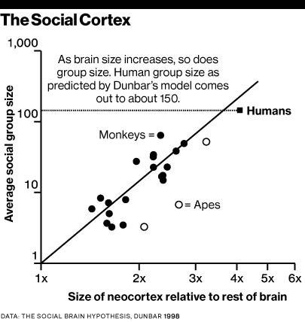
Ego networks: Social brain hypothesis
Why is your (human) head so big?
  In comparison to our closest primate ancestors
Because humans are very social animals!
  Finding:
    Neocortex size scales with average group size for all primates
  Explanation:
    The brain is for keeping track of other people (among other things)
Dunbar, R. I. M. (2003a, November 14). Evolution of the social brain. Science, 302, 1160 –1161.

Slide 29
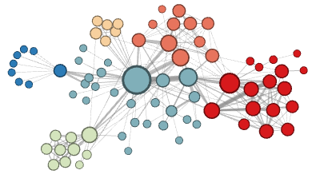
Why do your ego networks look they way they do?
The composition of your ego network is likely biased
  How are your ego networks biased?
    Some kinds of people are over-represented in your ego-network
    Some kinds of people are under-represented in your ego network
    The people who are over-represented are more likely to be similar to you
    The people who are under-represented are more likely to be dissimilar to you
      These last two things are the basis of homophily*
*McPherson, M., Smith-Lovin, L., & Cook, J. M. (2001). Birds of a feather: Homophily in social networks. Annual Review of Sociology, 27(1), 415-444.

Slide 30
Why do your ego networks look they way they do?
In what ways are your networks biased toward homophily?
  According to pretty much any social distinction we can think of
    Gender
    Race/Ethnicity
    Education
    Age
    Occupation/Income
  These are what Peter Blau called dimensions of association
    Some of these are categorical (no inherent ordering)
      Like race , gender or occupation
    Some are continuous (inherent ordering)
      Like age, education or income

Slide 31

Why do your ego networks look they way they do?
Why are your ego networks biased toward homophily?
  One obvious source of bias is what has been called* choice homophily
    You like to hang out with people who are similar to you (regardless)
  One non-obvious source of bias is what has been called* induced homophily
    The social context (nation, state, organization) where you reside determines the people who are available for you to hang out with
*McPherson, J. M., & Smith-Lovin, L. (1987). Homophily in voluntary organizations: Status distance and the composition of face-to-face groups. American Sociological Review, 370-379.
Peter Blau (1918 - 2002)

Slide 32


Why do your ego networks look they way they do?
The World
Your ego network
Peter Blau (1918 - 2002)
Unbiased
Biased

Slide 33
Why do your ego networks look they way they do?
The World
Your ego network
Peter Blau (1918 - 2002)
Unbiased
Biased

Slide 34
Why do your ego networks look they way they do?
The World
Your ego network
Peter Blau (1918 - 2002)
Unbiased
Biased

Slide 35
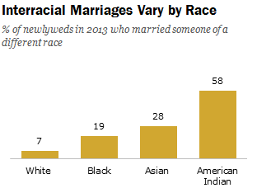
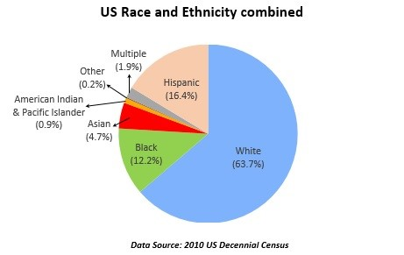
Blau’s rules: Group size effects
If a categorical dimension divides the population into two or more groups:
  Rule 1: Members of numerically smaller groups will be more likely to have relations with outgroup members
  Rule 2: Members of numerically larger groups will be more likely to have relations with ingroup members
These are called group size effects

Slide 36
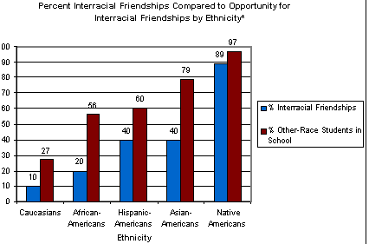
Blau’s rules: Group size effects
If a categorical dimension divides the population into two or more groups:
  Rule 1: Members of numerically smaller groups will be more likely to have relations with outgroup members
  Rule 2: Members of numerically larger groups will be more likely to have relations with ingroup members
These are called group size effects
Source: Joyner, K. & Kao, G. (2000). School racial composition and adolescent racial homophily. Social Science Quarterly, 81, 810-825.

Slide 37

Blau’s rules: Multiform heterogeneity effects
Rule 3:
Example:
  In the U.S. there are systematic correlations between religion and race
Multiform Heterogeneity Effect:
  Network biased by race will also be biased by religion
  Even if people don’t have preferences religion of alter (or vice versa)

Slide 38
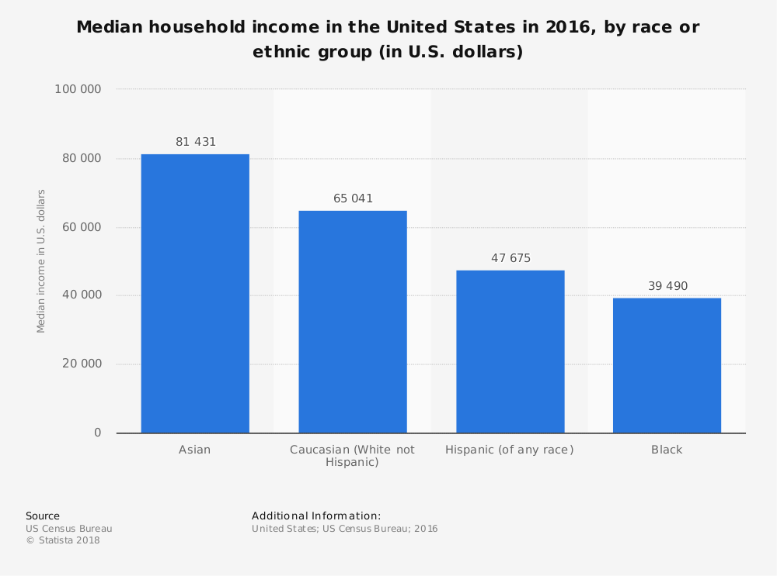
Blau’s rules: Multiform heterogeneity effects
This applies to any correlation between dimensions of association
  Categorical-Categorical (e.g., Race and Religion)
    Networks biased by religion will be biased by race
  Categorical-Continuous (e.g., Race and Income)
    Networks biased by race will be biased by income
  Continuous-Continuous (e.g., Age and Income)
    Neworks biased by age will be biased by income

Slide 39

Focused organizations of social ties
One observation:
  Often social relations are organized around “circles,” or “common activities”
  These “foci” may themselves be a primary driver of which relations show up in people’s networks
What is a “focus”?
  “ a social, psychological, legal, or physical entity around which joint activities are organized (e.g., workplaces, voluntary organizations, hangouts, families, etc.” (Feld 1981: 1016)

Slide 40

Why do your ego networks look they way they do?
Church
Family
School
You
Scott Feld
Unbiased!

Slide 41
Why do your ego networks look they way they do?
Church
Family
School
You
Scott Feld
Unbiased!

Slide 42
Why do your ego networks look they way they do?
The typical settings within which you interact as reference for bias:
  Feld Rule: If the settings within which you interact are biased towards a particular categorical or continuous dimension of association your ego-network will reflect that bias
    Feld referred to these settings as social foci
    Therefore, this is the called the focus effect
      Foci make homophily happen via segregation
    Conversely,
      Desegregated foci reduce homophily
Scott Feld

Slide 43

Focused organizations of social ties
This suggests two new mechanisms for where ties come from:
b
a
c
Ego
h
d
From circle to relation
g
e
f
From common activity to relation

Slide 44
Focused organizations of social ties
Foci vary around several dimensions
  Constraint
    Time and energy that they require
  Size
Foci emerge from pre-existing relations
  Friends form clubs, participate in common activities
Multiple intersecting foci
  “Cross-cutting” circles
  Clustering at the ego-network level may be the result of constraining overlapping foci
b
a
c
Ego
h
d
g
e
f

Slide 45

Why do your ego networks look they way they do?
The World
Your ego network
Small
Large
Peter Marsden
More biased
Less Biased

Slide 46
Why do your ego networks look they way they do?
Overall, larger ego networks should be more diverse
  Regardless of preferences for choice homophily
    At some point you run out of ingroup alters!
But this effect should depend group size effects
  In general, minorities should get more “bang from their buck” (in terms of diversity) from network size
    Can you tell why?
Peter V. Marsden

Slide 47
Why do your ego networks look they way they do?
Overall, larger ego networks should be more diverse
  Regardless of preferences for choice homophily
    At some point you run out of ingroup alters!
But this effect should depend group size effects
  In general, minorities should get more “bang from their buck” (in terms of diversity) from network size
    Can you tell why?
A
B

Slide 48

Why do your ego networks look they way they do?
A
B

Slide 49
Ego networks
Ego: Central node
Alters: Nodes around ego
  Obligatory links from ego to every alter
  Optional links from alter to alter
b
a
c
Ego
h
d
g
e
f

Slide 50
Ego networks
Properties of ego networks:
  Size
    How many total alters?
  Diversity
    Alters different from ego?
  Composition
    Prop. of certain types of alter
  Clustering
    Are alters densely or loosely connected to one another?
b
a
c
Ego
h
d
g
e
f

Slide 51
Ego networks
Properties of ego networks:
  Size
    Number of ego-alter ties
  Diversity
    Variation in alter attributes
  Homophily/Heterophily
    Ties to alter same/different from ego
  Composition
    Prop. of certain types of alter ties
  Clustering
    Density of alter-alter network
Measure | Ego-alter ties | Alter-Alter Ties | Attributes
Size | ✅
Diversity |  |  | ✅
Homophily |  |  | ✅
Composition | ✅
Clustering |  | ✅

Slide 52
Ego networks: Clustering Coefficient
b
a
 | a | b | c | d | e | f | g | h
a | --
b |  | --
c |  |  | --
d |  |  |  | --
e |  |  |  |  | --
f |  |  |  |  |  | --
g |  |  |  |  |  |  | --
h |  |  |  |  |  |  |  | --
c
Ego
d
h
g
e
f

Slide 53
Ego networks: Clustering Coefficient
b
a
 | a | b | c | d | e | f | g | h
a | --
b |  | --
c |  |  | --
d |  |  |  | --
e |  |  |  |  | --
f |  |  |  |  |  | --
g |  |  |  |  |  |  | --
h |  |  |  |  |  |  |  | --
c
d
h
g
e
f
Forget about Ego!
We only care about alter-alter edges

Slide 54
Ego networks: Clustering Coefficient
b
a
 | a | b | c | d | e | f | g | h
a | -- | 1 | 0 | 0 | 0 | 0 | 1 | 1
b | 1 | -- | 0 | 0 | 0 | 0 | 1 | 1
c | 0 | 0 | -- | 0 | 0 | 0 | 0 | 0
d | 0 | 0 | 0 | -- | 1 | 1 | 1 | 0
e | 0 | 0 | 0 | 1 | -- | 1 | 0 | 0
f | 0 | 0 | 0 | 1 | 1 | -- | 1 | 0
g | 1 | 1 | 0 | 1 | 0 | 1 | -- | 1
h | 1 | 1 | 0 | 0 | 0 | 0 | 1 | --
c
d
h
g
e
f
Forget about Ego!
We only care about alter-alter edges

Slide 55
Ego networks: Clustering Coefficient
b
a
 | a | b | c | d | e | f | g | h
a | -- | 1 | 0 | 0 | 0 | 0 | 1 | 1
b | 1 | -- | 0 | 0 | 0 | 0 | 1 | 1
c | 0 | 0 | -- | 0 | 0 | 0 | 0 | 0
d | 0 | 0 | 0 | -- | 1 | 1 | 1 | 0
e | 0 | 0 | 0 | 1 | -- | 1 | 0 | 0
f | 0 | 0 | 0 | 1 | 1 | -- | 1 | 0
g | 1 | 1 | 0 | 1 | 0 | 1 | -- | 1
h | 1 | 1 | 0 | 0 | 0 | 0 | 1 | --
c
d
h
g
e
f
How many nodes? N = 8
How many total links? E = 22/2 = 11
We only care about half!

Slide 56
Ego networks: Clustering Coefficient
b
a
 | a | b | c | d | e | f | g | h
a | -- | 1 | 0 | 0 | 0 | 0 | 1 | 1
b | 1 | -- | 0 | 0 | 0 | 0 | 1 | 1
c | 0 | 0 | -- | 0 | 0 | 0 | 0 | 0
d | 0 | 0 | 0 | -- | 1 | 1 | 1 | 0
e | 0 | 0 | 0 | 1 | -- | 1 | 0 | 0
f | 0 | 0 | 0 | 1 | 1 | -- | 1 | 0
g | 1 | 1 | 0 | 1 | 0 | 1 | -- | 1
h | 1 | 1 | 0 | 0 | 0 | 0 | 1 | --
c
d
h
g
e
f
How many nodes? N = 8
How many total links? E = 22/2 = 11
How many possible number of links? (N*(N - 1)/2 = (8*7)/2 = 28

Slide 57
Ego networks: Clustering Coefficient
b
CC_{ego}= E/(N*(N - 1)/2)
CC_{ego} = 11/28
CC_{ego}= 0.39
a
 | a | b | c | d | e | f | g | h
a | -- | 1 | 0 | 0 | 0 | 0 | 1 | 1
b | 1 | -- | 0 | 0 | 0 | 0 | 1 | 1
c | 0 | 0 | -- | 0 | 0 | 0 | 0 | 0
d | 0 | 0 | 0 | -- | 1 | 1 | 1 | 0
e | 0 | 0 | 0 | 1 | -- | 1 | 0 | 0
f | 0 | 0 | 0 | 1 | 1 | -- | 1 | 0
g | 1 | 1 | 0 | 1 | 0 | 1 | -- | 1
h | 1 | 1 | 0 | 0 | 0 | 0 | 1 | --
c
Ego
d
h
g
e
f
How many nodes? N = 8
How many total links? E = 22/2 = 11
How many possible number of links? (N*(N - 1)/2 = (8*7)/2 = 28

Slide 58
Ego networks: Clustering Coefficient
a
b
a
b
a
b
Ego
Ego
Ego
c
d
c
d
c
d
 | a | b | c | d
a | -- | 0 | 0 | 0
b | 0 | -- | 0 | 0
c | 0 | 0 | -- | 0
d | 0 | 0 | 0 | --
 | a | b | c | d
a | -- | 1 | 1 | 0
b | 1 | -- | 0 | 0
c | 1 | 0 | -- | 1
d | 0 | 0 | 1 | --
 | a | b | c | d
a | -- | 1 | 1 | 1
b | 1 | -- | 1 | 1
c | 1 | 1 | -- | 1
d | 1 | 1 | 1 | --
CC_{ego}= 0
CC_{ego}= 0.5
CC_{ego}= 1.0
Unclustered
Clustered

Slide 59
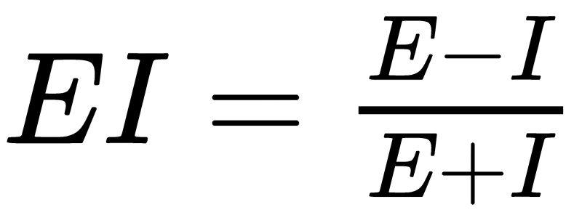
Ego networks: EI Homophily Index
Difference in number of External Ties (E) to Internal Ties (I) Divided by their Sum
Different Race Tie
Same Race Tie
a
b
a
b
a
b
Ego
Ego
Ego
c
d
c
d
c
d
EI_{ego}= (4-0) ÷ (4+0) = 1
EI_{ego}= (2-2) ÷ (2+ 2) = 0
EI_{ego}= (0 -4) ÷ (0 + 4) = -1
Four external ties, no internal ties
Two external ties, and two internal ties
No external ties, and four internal ties

Slide 60
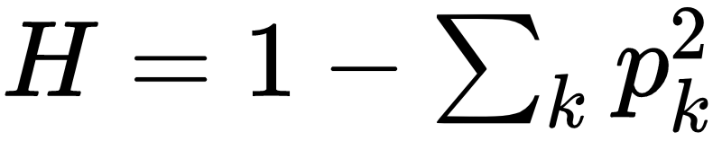
Ego networks: Blau’s Index of Heterogeneity (H)
White
One minus the sum of squared proportions of alters from each group
Hispanic
Black
Asian
a
b
a
b
a
b
a
b
Ego
Ego
Ego
Ego
c
d
c
d
c
d
c
d
H = 1 - (4/4)²
H = 1 - 1²
H = 1 - 1
H = 0
H = 1 - [(¼)² + (¾)²]
H = 1 -(0.25² + 0.75²)
H = 1 - (0.06 + 0.56)
H = 0.38
H = 1 - [(¼)² + (¼)² + (½)²]
H = 1 -(0.25² + 0.25² + 0.5²)
H = 1 - (0.06 + 0.06 + 0.25)
H = 0.63
H = 1 - [(¼)² + (¼)² + (¼)² + (¼)²]
H = 1 -(0.25² + 0.25² + 0.25² + 0.25²)
H = 1 - (0.06 + 0.06 + 0.06 + 0.06)
H = 0.76

Slide 61
Types of ties in ego networks
Role relations (states)
  Friends, kin, business partners
Interpersonal sentiments and cognitions
  Liking, trusting, acquaintanceship
Behavioral Social Interactions
  Calling, texting, citing, supporting, resource exchange
b
a
c
Ego
d
h
g
e
f

Slide 62
Measuring ego networks: Four steps
Pick a type of relation you are interested in
  This defines your name generator
Pick a maximum number
  E.g. 5-20
Pick a set of altern and tie-level characteristics you are interested in
  This defines your name interpreter
Collect information about relations between alters (optional)
b
a
c
Ego
d
h
g
e
f

Slide 63
Name generators: Four approaches
Role-Relation Approach
  Neighbors, friends, kin, co-authors
Interaction Approach
  Frequency, duration of contact
Affective Approach
  Significant, close, enemies
Exchange Approach
  Information, favors, support, resources
    Different approaches can produce ego-networks with different structural characteristics!
b
a
c
Ego
d
h
g
e
f

Slide 64
Name generators: Four approaches
Role-Relation Approach
  “list the names of up to [X] [friends, co-workers, co-authors, pub-mates, etc.]”
Interaction Approach
  “list the names of up to [X] of the people you most frequently interact with
Affective Approach
  “list the names of up to [X] of the people you [feel closest to, trust most, etc.]”
Exchange Approach
  “list the names of up to [X] of the people you would go to for [advice, financial support, etc.]
b
a
c
Ego
d
h
g
e
f

Slide 65
Name generators: Four approaches
Famous examples:
  Wellman’s (1979) East York Study:
    “Name the six persons outside your home that you feel closest to.”
  Fischer’s (1982) Northern California Communities Study:
    “Name all persons who would provide any of eight types of aid”
  Marsden’s (1987) General Social Survey:
    “Named all persons with whom you have discussed matters important to you”
b
a
c
Ego
d
h
g
e
f

Slide 66

Name interpreters
Follow up questions designed to get information on named alters
  Socio-demographic characteristics of alter
    Gender
    Age
    Race
    Years of Education
    Relationship to the organization
    Religion
    Etc.

Slide 67

Name interpreters
Follow up questions designed to get information on named alters
  Socio-demographic characteristics of alter
    Sex/Gender
    Age
    Race
    Years of Education
    Relationship to the organization
    Religion
    Etc.

Slide 68

Name interpreters
Follow up questions designed to get information on named alters
  Socio-demographic characteristics of alter
    Gender
    Age
    Race
    Years of Education
    Relationship to the organization
    Religion
    Etc.

Slide 69

Name interpreters
Follow up questions designed to get information on named alters
  Socio-demographic characteristics of alter
    Gender
    Age
    Race
    Years of Education
    Relationship to the organization
    Religion
    Etc.

Slide 70

Name interpreters
Follow up questions designed to get information on elicited relations
  Role-relations
    Friends, co-workers, co-authors, pub-mates
  Sentiments
    Loving, exciting, significant, negative sentiments (difficult person)
  Exchanges and Support
    Advice, would go to for financial help, discuss important matters, etc.

Slide 71

Name interpreters
Follow up questions designed to get information on elicited relations
  Role-relations
    Friends, co-workers, co-authors, pub-mates
  Sentiments
    Closeness, negative sentiments (difficult person)
  Exchanges and Support
    Advice, would go to for financial help, discuss important matters, etc.

Slide 72

Name interpreters
Follow up questions designed to get information on elicited relations
  Role-relations
    Friends, co-workers, co-authors, pub-mates
  Sentiments
    Closeness, negative sentiments (difficult person)
  Exchanges and Support
    Advice, would go to for financial help, discuss important matters, etc.

Slide 73

Name interpreters
Follow up questions designed to get information on elicited relations
  Relationship age or duration
  Subjective similarity
  “Cultural matching”
    Does alter share tastes, attitudes, practices with ego?

Slide 74

Name interpreters
Follow up questions designed to get information on elicited relations
  Relationship age or duration
  Subjective similarity
  “Cultural matching”
    Does alter share tastes, attitudes, practices with ego?

Slide 75

Name interpreters
Follow up questions designed to get information on elicited relations
  Relationship age or duration
  Subjective similarity
  Similarities/Matching in Cultural Pursuits
    Does alter share tastes, attitudes, practices with ego?

Slide 76
Alternatives: Position Generators
“Do you know anyone who is a/an….”
  Lawyer
  Doctor
  Mechanic
  Teacher
  Secretary
  Haridresser
  Cook
  Farmer
  Mailman
  Policeman
  [...] And whatever other occupations you can imagine

Slide 77

Alternatives: Position Generators

Slide 78
Alternatives: Resource Generators
“Do you know anyone who…”
  Can repair a car, bike, etc.
  Is handy repairing household equipment
  Can speak and write a foreign language
  Can work with a personal computer
  Has good contacts with a newspaper, radio or TV station
  Has knowledge about financial matters (taxes, subsidies)
  Can give advice concerning a conflict at work
  Can help when moving house (packing, lifting)
  Can help with small jobs around the house (carpentering, painting)
  [...] And whatever else you can imagine

Slide 79

Alternatives: Resource Generators

